Slide 1
WEED MANAGEMENT IN ORGANIC FARMING
Sahil Burde (C)
Anirudha Rajodiya
Girdhari Sansi
Patlavath Vinod Nayak
Deepika Sravya
Santosh Mudavath
V. Ganesh

Slide 2
Content
Weed?
Herbicides used in India
Herbicide currently using
Effect of Herbicides
Thermal Weeding Bot
Switch To Organic
Conclusion

Slide 3
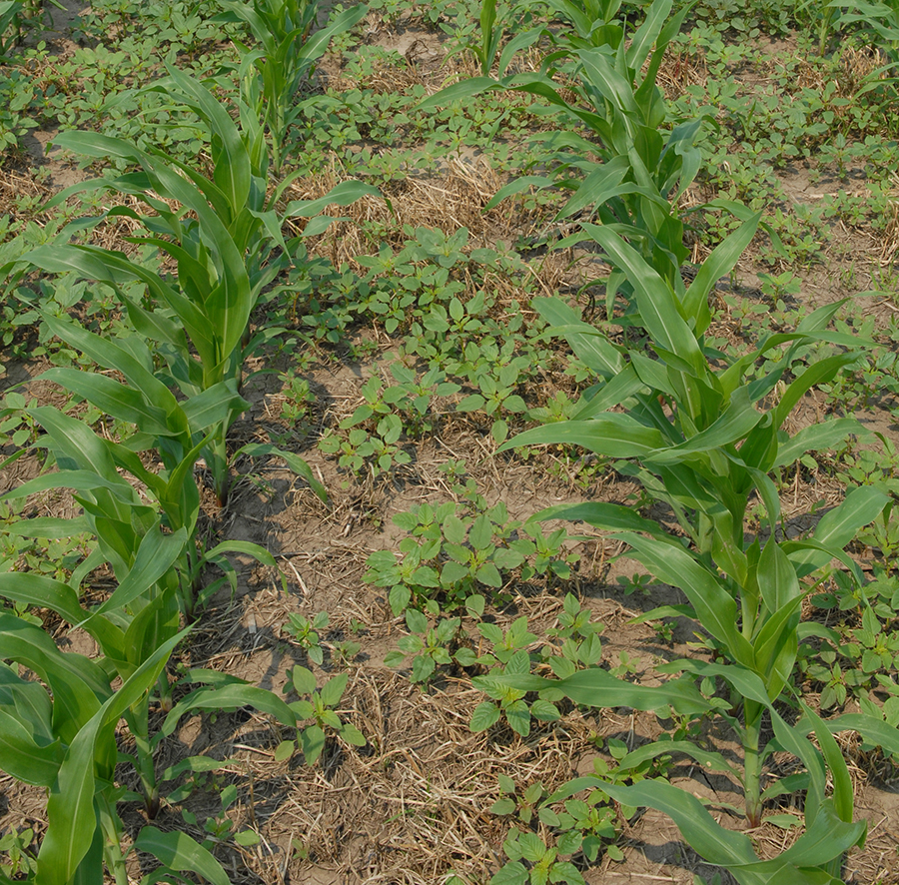
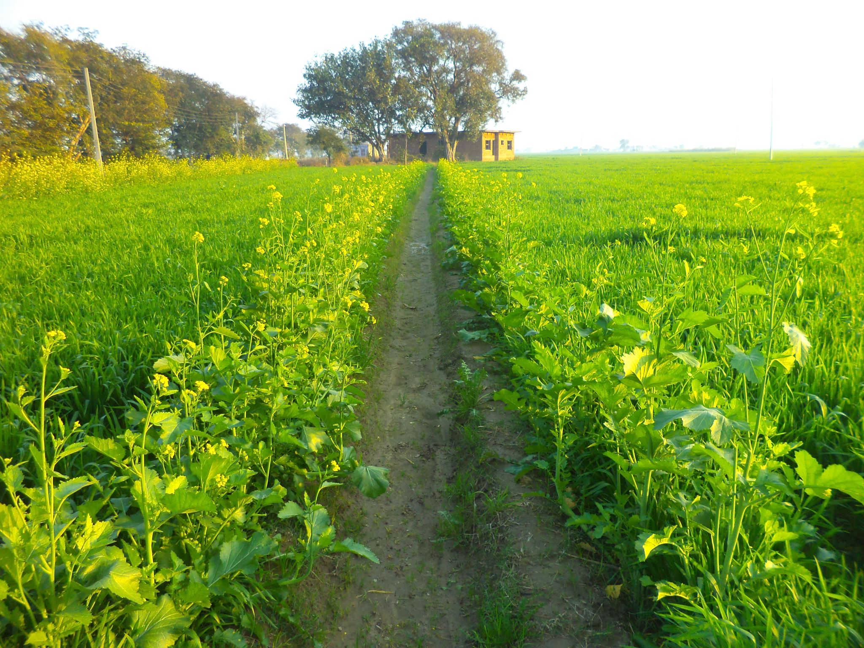
Weed?

Slide 4
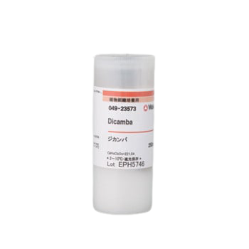
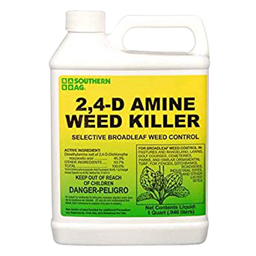
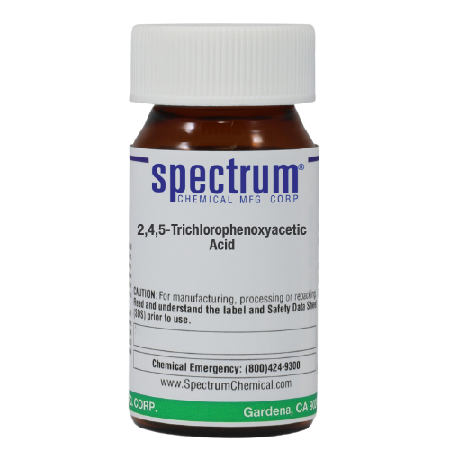
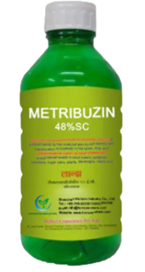
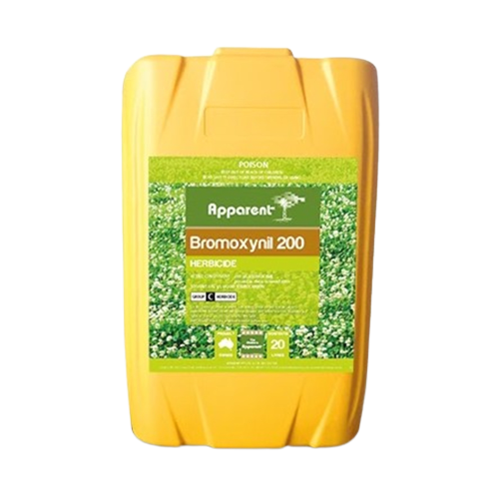
Some Herbicides:
2,4,5-T: (2,4,5-Tricholophenoy Acetic Acid)
Metribuzin
2,4-D:
(2,4-Dichlorophenoxy Acid)
(3,6-Dichloro-2-Methoxybenzoic Acid)
Bromoxynil

Slide 5
2. Effect of Herbicide
A sensitive effect on soil.
Contamination of underground water.
Can affect people nearby.

Slide 6
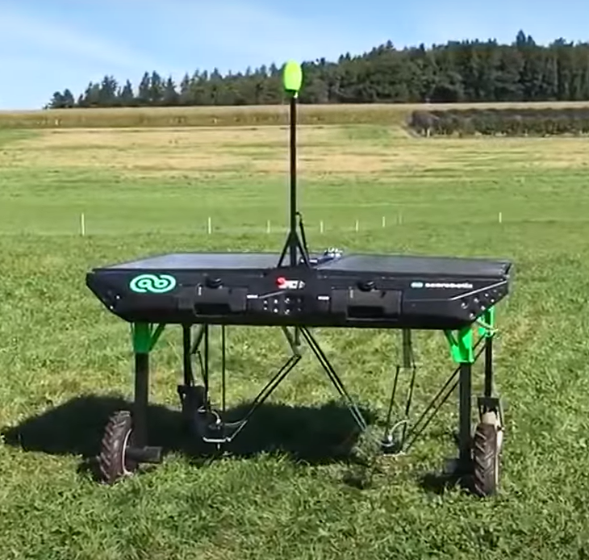
Thermal Weeding bot
Specifications:-
Solar panels 380W
Weight 130 Kg
Maximum Speed 1.3 feet per second
Height 9.8 feet
Tank Capacity 30 liters

Slide 7
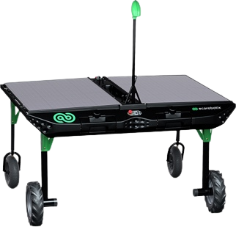
2.
1.
6.
1. Photovoltaic panels
2. Camera and artificial vision for guidance
and positioning
3. Navigation by GPS and sensors
4. Electrical drive
5. Rapid robotic arms with sprayers
6. Tanks for two different products
3.
5.
4.

Slide 8
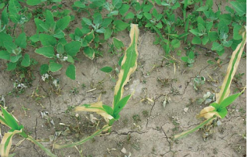
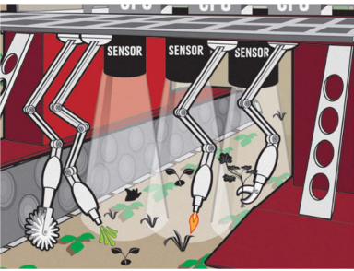
How does it work?
Closeup view of burned common lambsquarters in the corn row. The burned corn leaves did not result in a reduced corn yield because the corn growing point is below the ground.

Slide 9
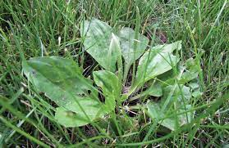
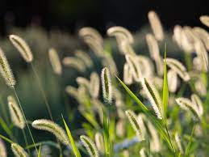
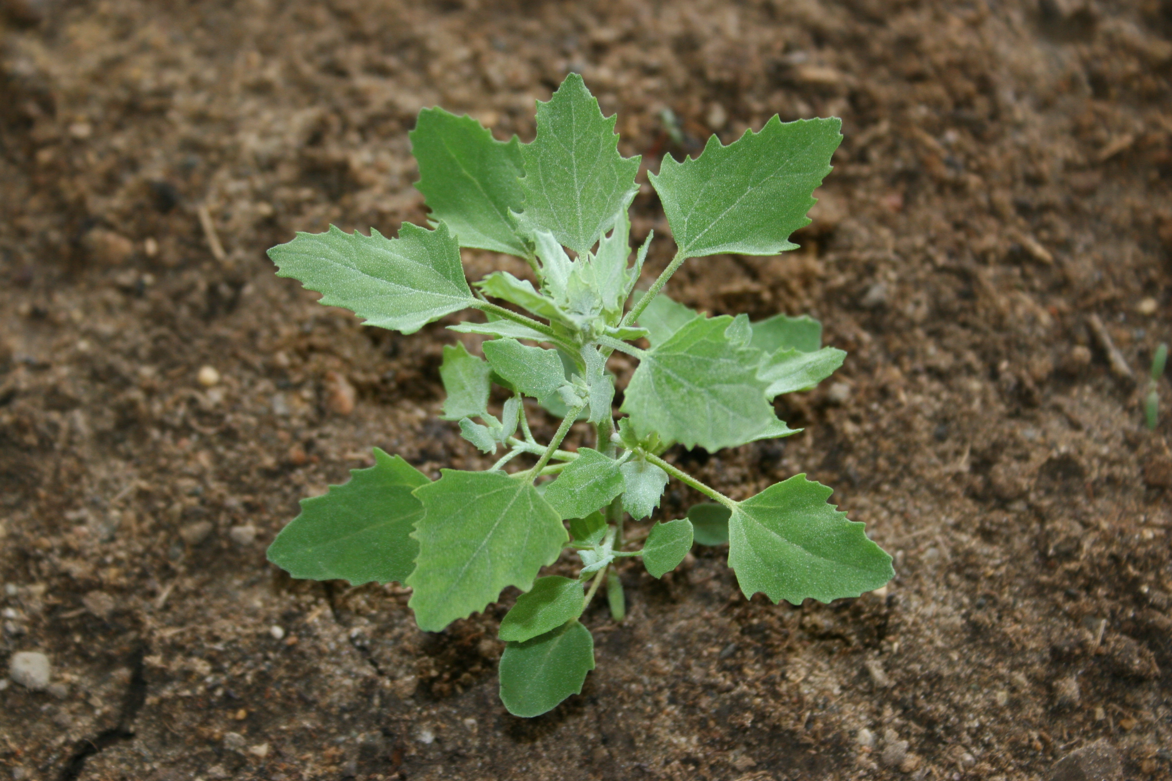
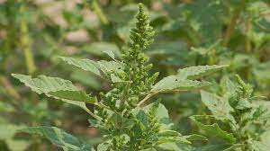
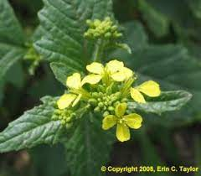
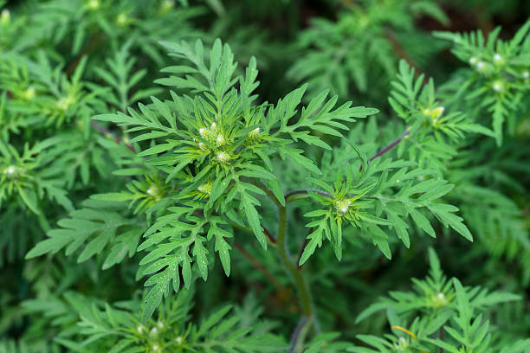
BroadLeaf Weed
Foxtail Weed
lambsquarters
pigweed
Mustard
RagWeed

Slide 10
Price Details:-
Photovoltaic Solar Panels
Robotic Arm and Electric Drive
01
04
Rs: 13945
Camera and AI Vision
Propane Tank
02
05
Rs: 2700
Sensor
TOTAL
03
Rs : 2000
>
Rs : 37745
Rs: 15600
Rs :4500

Slide 11
See the Difference
Herbicide
Propane
2-4 Dichlorophenoxyacetic acid
Around 10-15 k per Ha
6 Gallon per hour
Rs : 1588.95

Slide 12
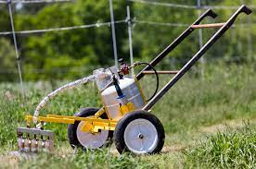
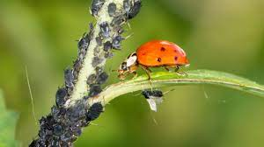
Switch To Organic
Protect The Future Environment

Slide 13

THANKS

